Slide 1

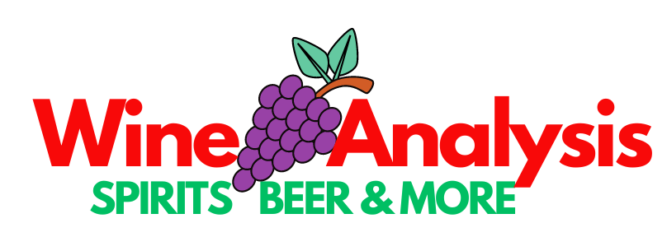

Slide 2

Topic
We are a Data Analysis team within Wotal Tine (a startup wine and spirits company) that have been tasked with assisting the Operations Team in selecting which wine to produce, and determining the association of wine reviews and descriptors from data scraped from WineEnthusiast.com during the week of November 22nd, 2017 to predict how our wine would perform.

Slide 3
Data
Points: the number of points WineEnthusiast rated the wine on a scale of 1-100 (through they say they only post reviews for wines that score >=80)
Title: the title of the wine review, which often contains the vintage if you're interested in extracting that feature
Variety: the type of grapes used to make the wine (ie Pinot Noir)
Description: a few sentences from a sommelier describing the wine's taste, smell, look, feel, etc.
Country: the country that the wine is from
Province: the province or state that the wine is from
Region 1: the wine growing area in a province or state (ie Napa)
Region 2: sometimes there are more specific regions specified within a wine growing area (ie Rutherford inside the Napa Valley), but this value can sometimes be blank
Winery: the winery that made the wine
Designation: the vineyard within the winery where the grapes that made the wine are from
Price: the cost for a bottle of the wine
Taster Name: name of the person who tasted and reviewed the wine
Taster Twitter Handle: Twitter handle for the person who tasted and reviewed the wine

Slide 4
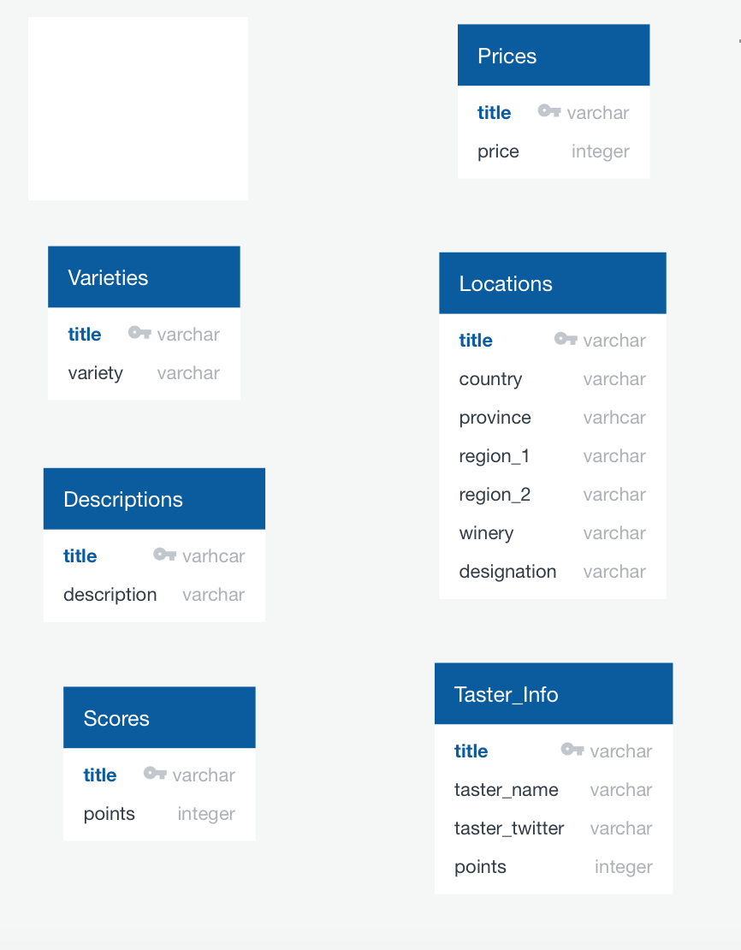
Data Mappings

Slide 5
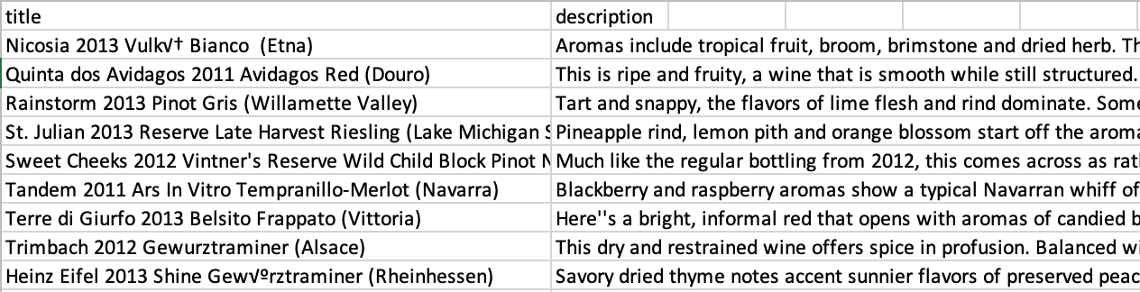
Wine by Description

Slide 6
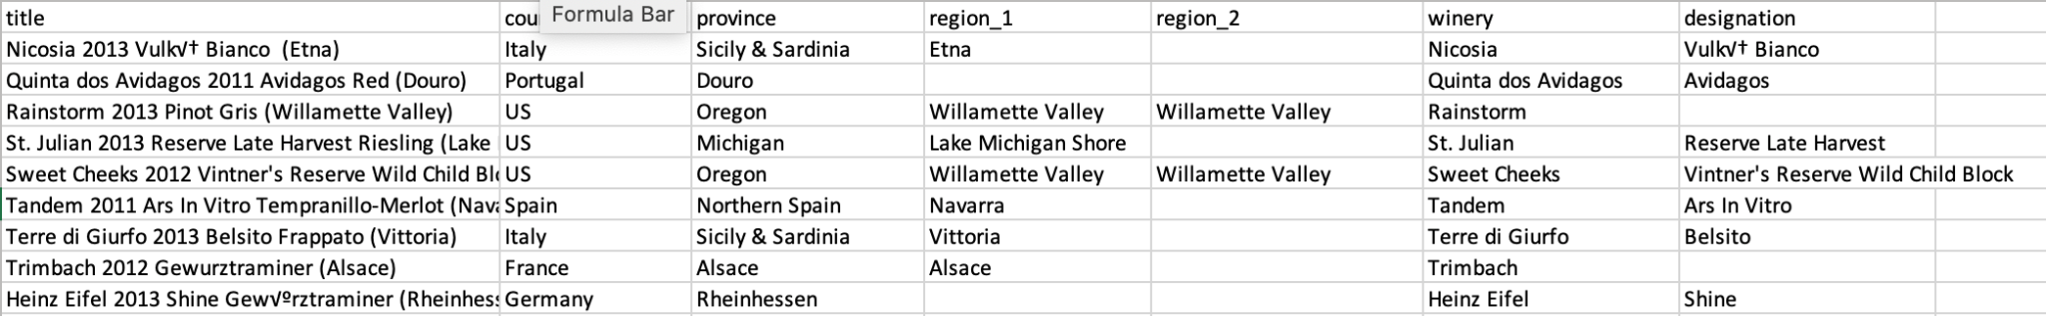
Wine by Location

Slide 7
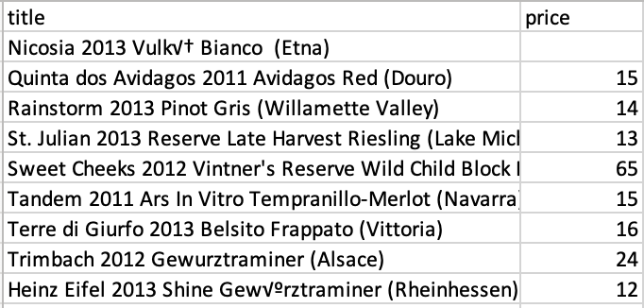
Wine by Price

Slide 8
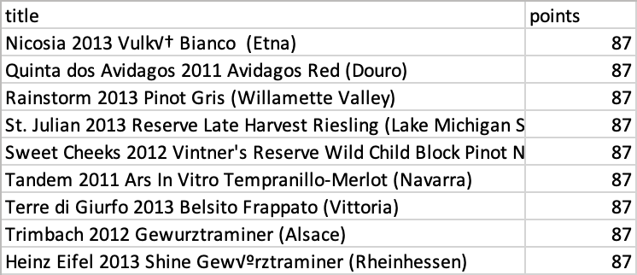
Wine by Score

Slide 9
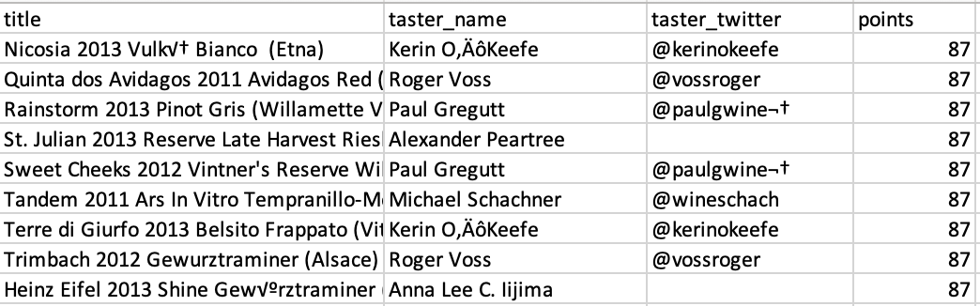
Wine by Taster Info

Slide 10
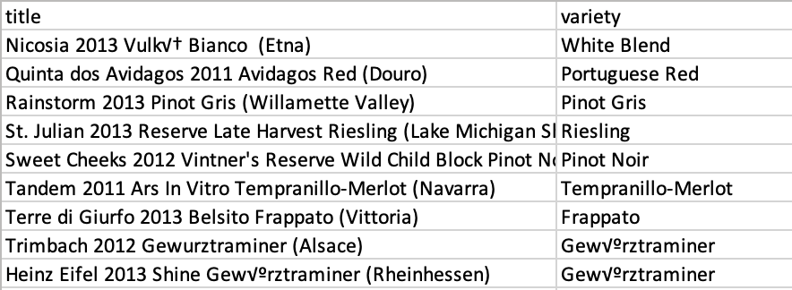
Wine by Variety

Slide 11
Questions
Which variant of wine should we choose to produce more of based on the reviews of our consumers?
Which winery should we choose to work with based on the variety we select and the reviews provided?
What is the average price of wine receiving above average reviews?

Slide 12
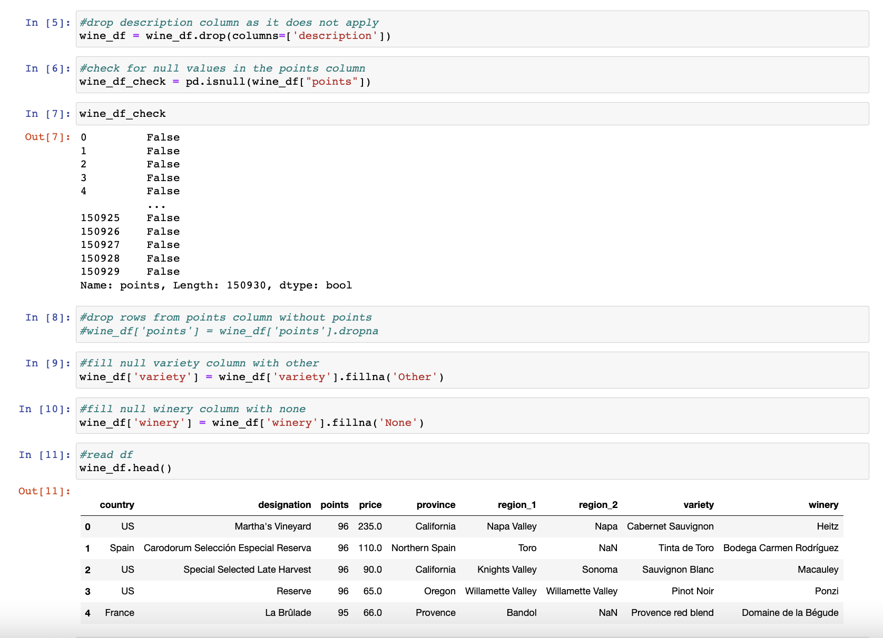
Data Analysis
Cleaning the Data

Slide 13
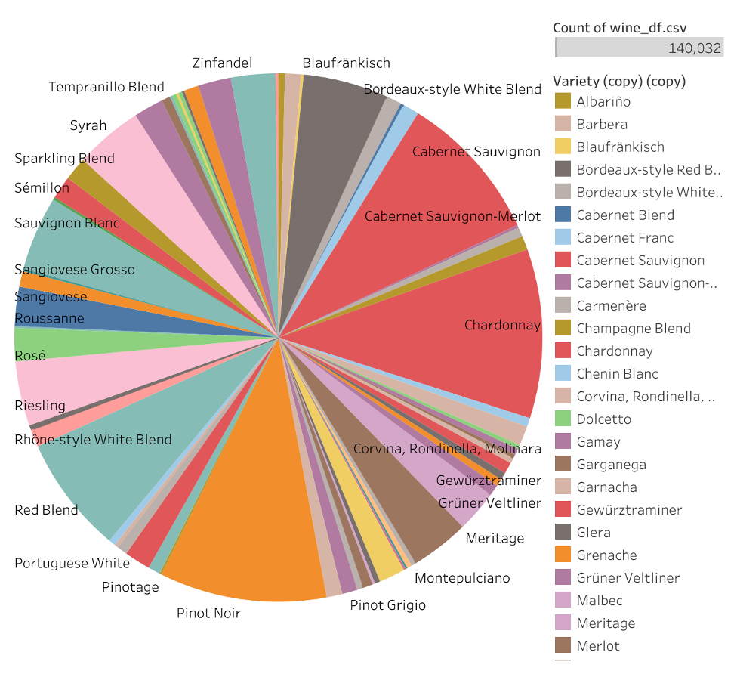
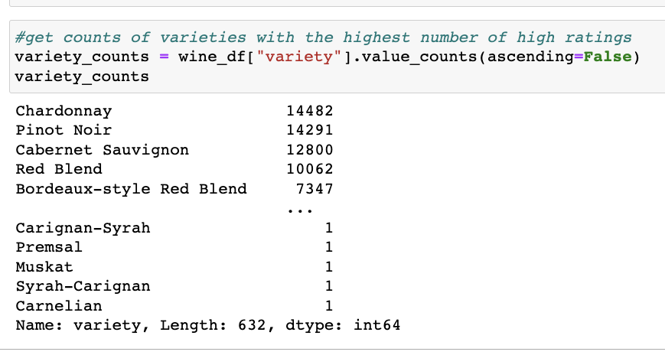
Findings
https://public.tableau.com/app/profile/iman.jacques/viz/Wine_Analysis_Story/Story1?publish=yes

Slide 14
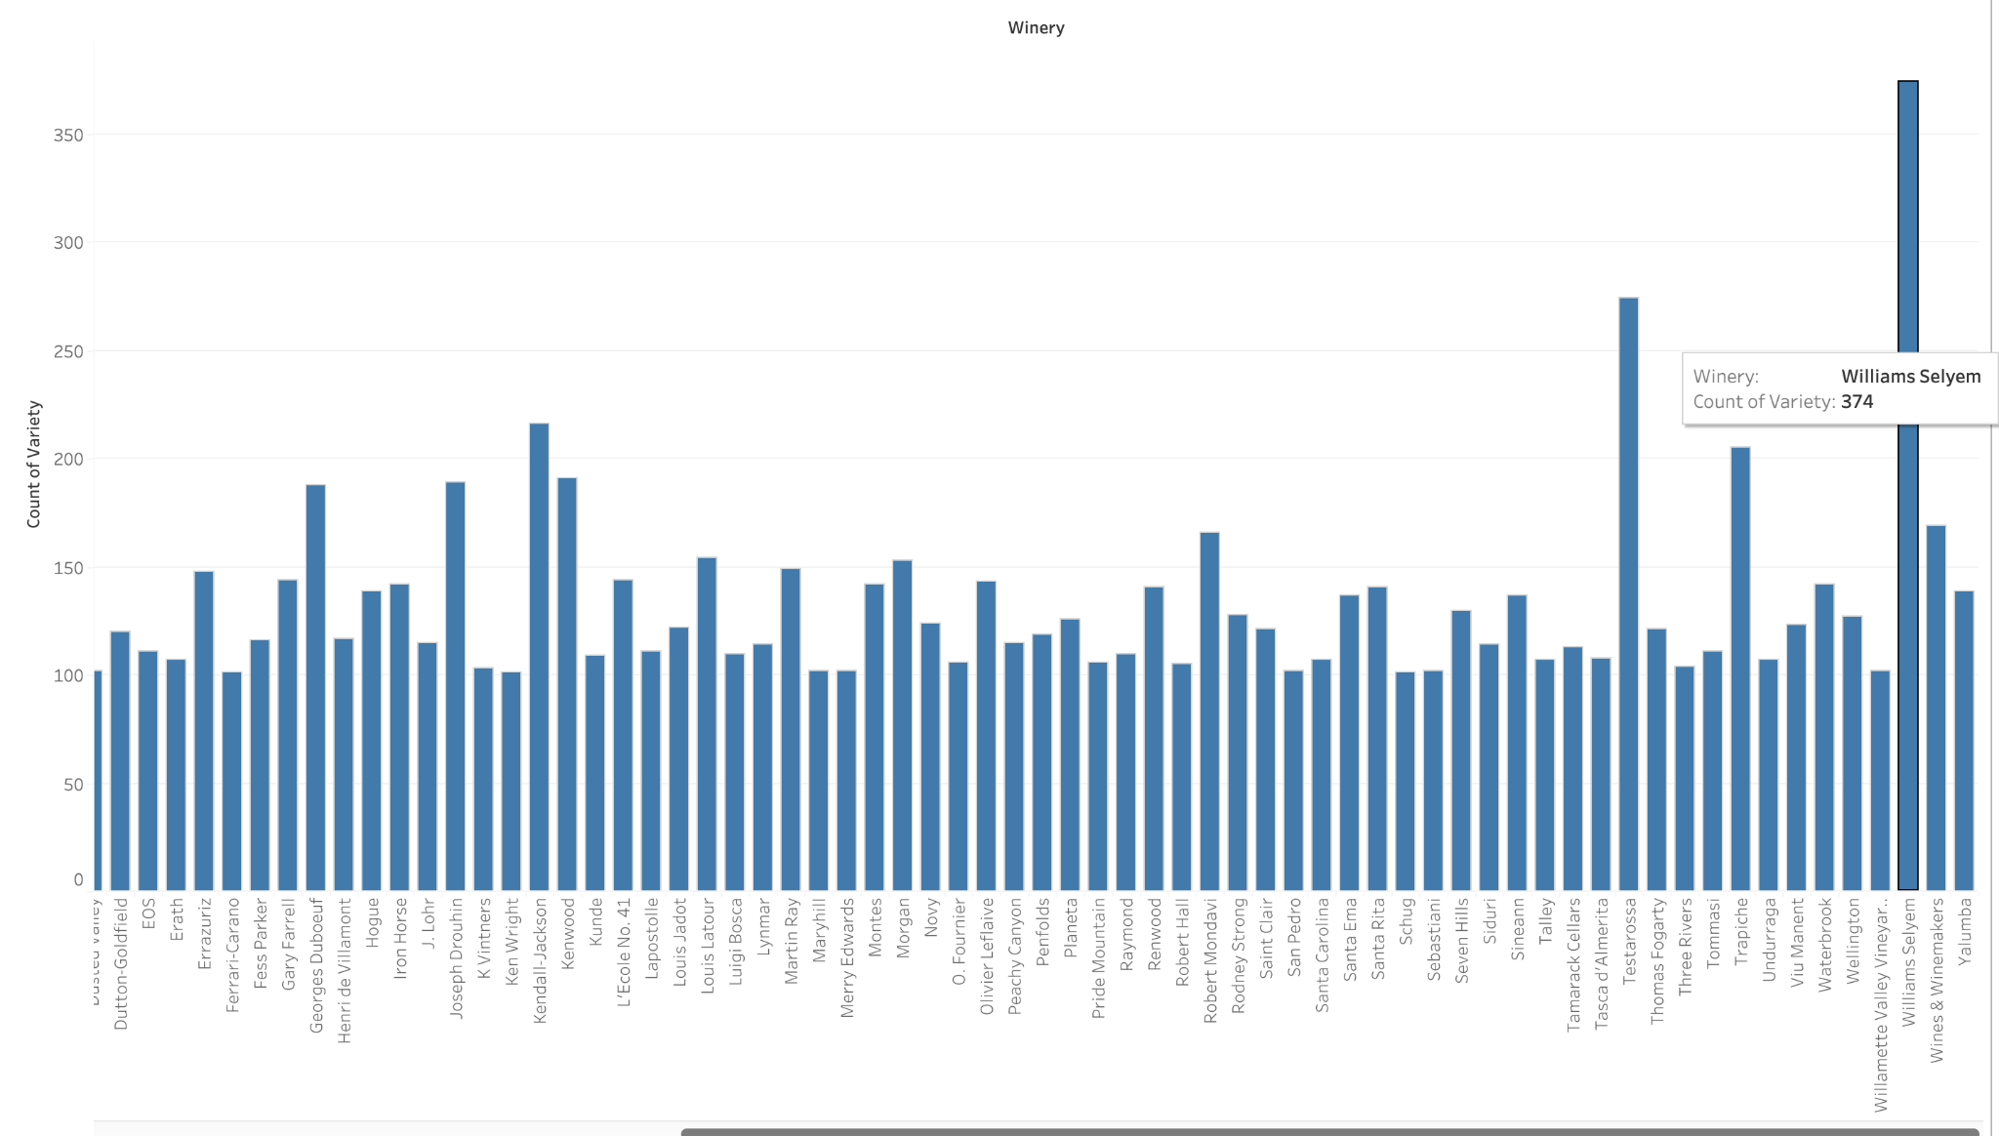
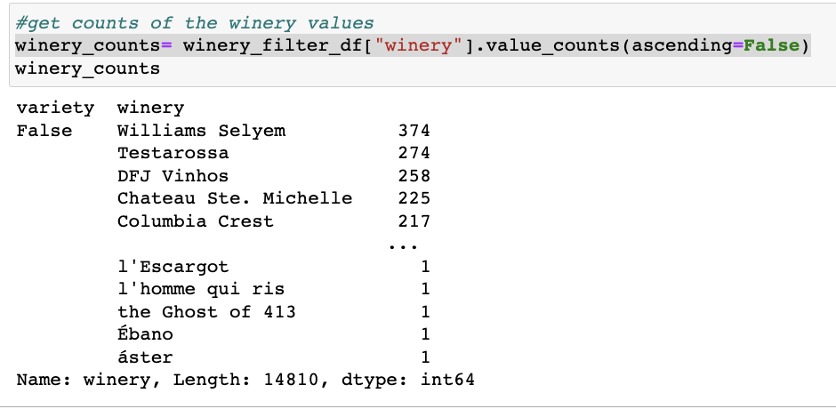
Findings

Slide 15
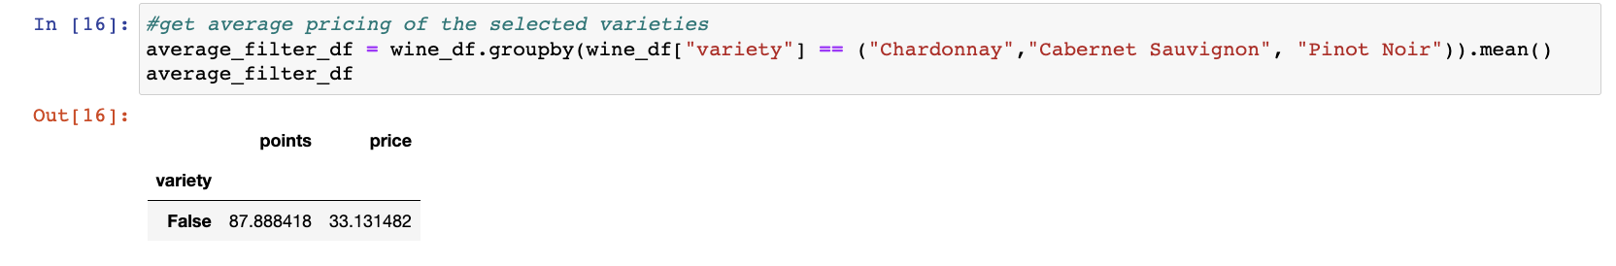
Findings

Slide 16
Predictions
Can we predict the scores of future wine tastings based on previous ones?
Does the description of the wines lead to a higher reviews/points?
Notes:
Do popular buzzwords lead to higher reviews? (Break down the description of the wines to find the most popular words used to describe the alcohol and determine if these popular words associate to higher reviews)

Slide 17
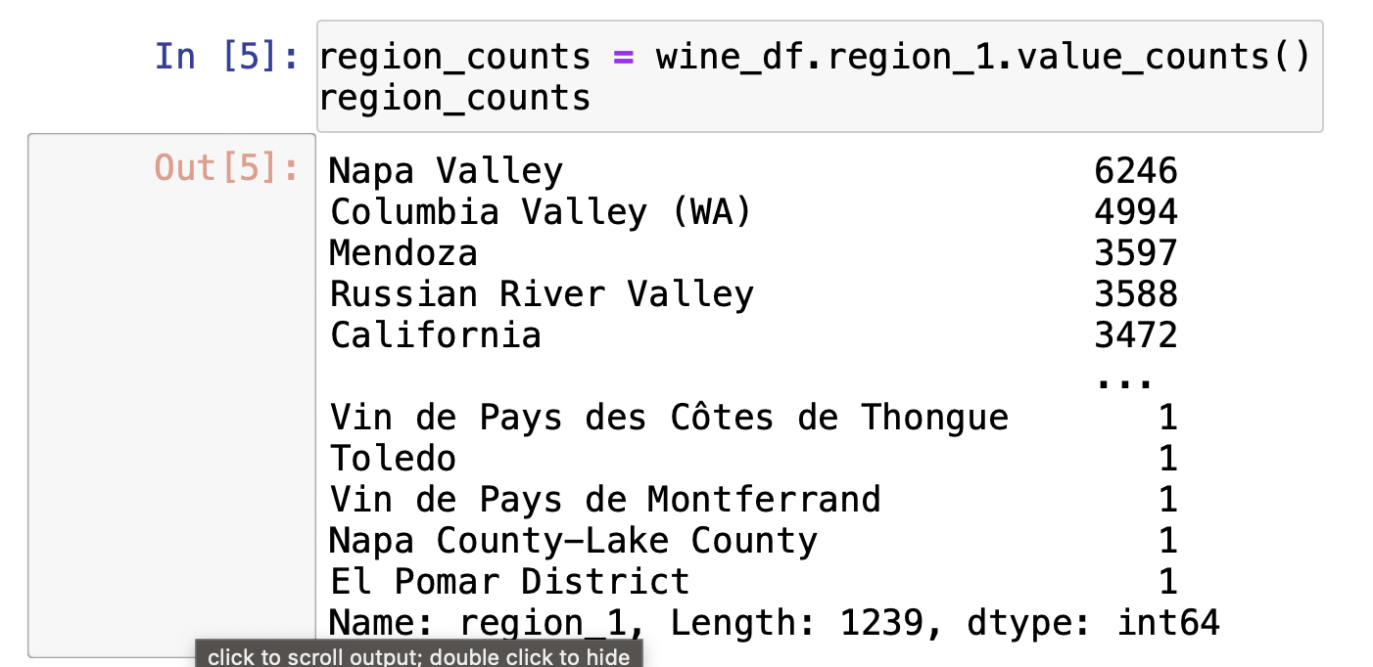
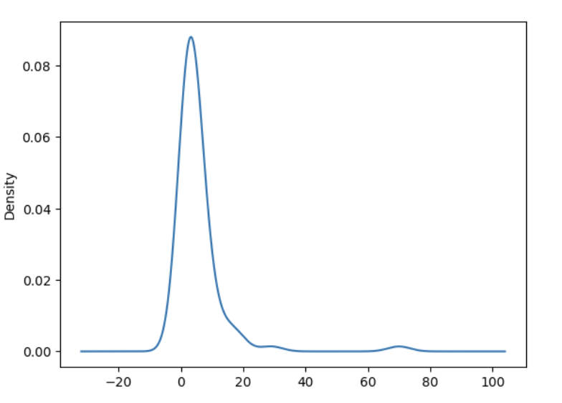
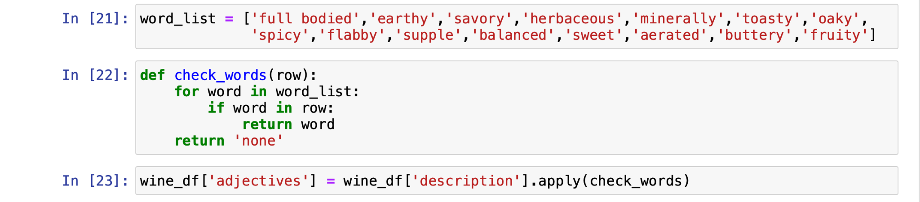
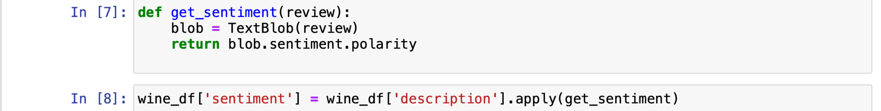
Machine Learning: Data Cleaning

Slide 18
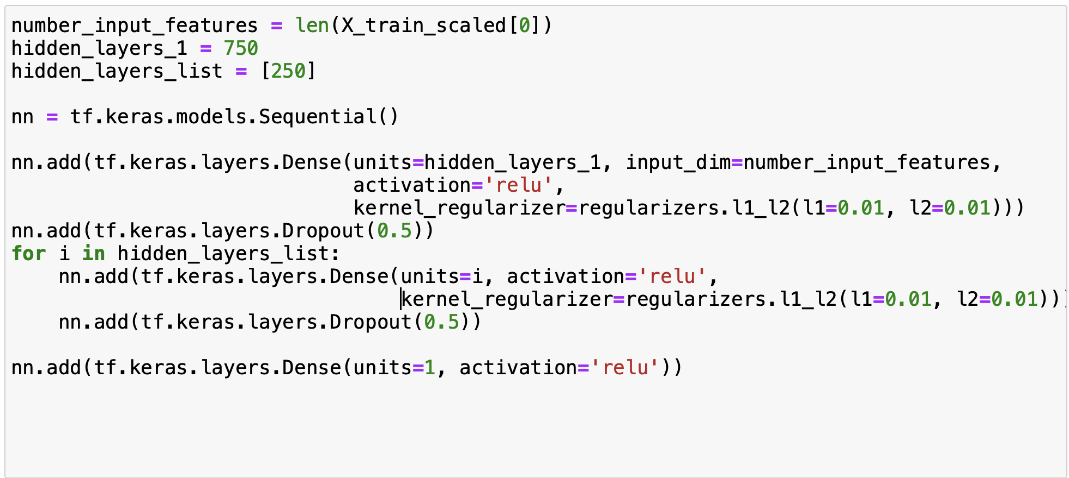
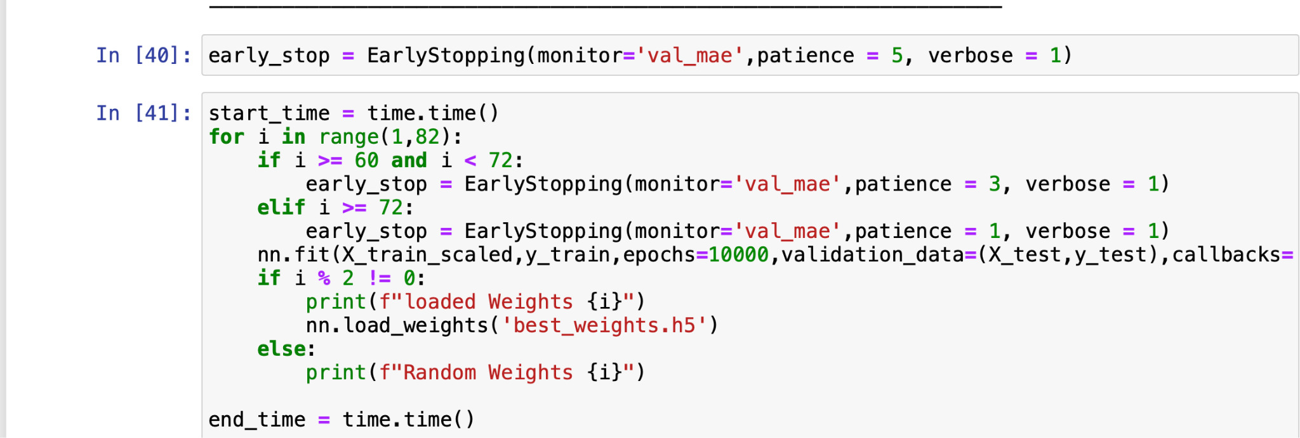
Machine Learning: Creating The Model

Slide 19
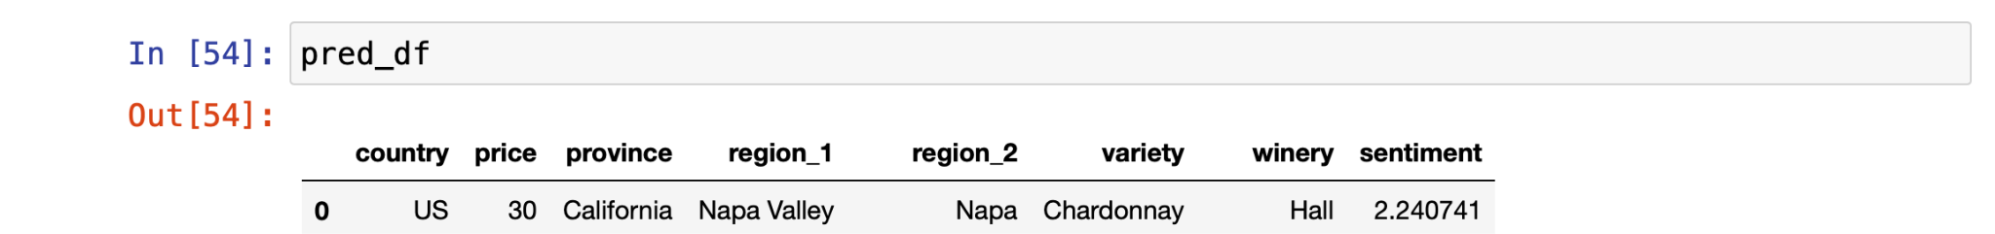
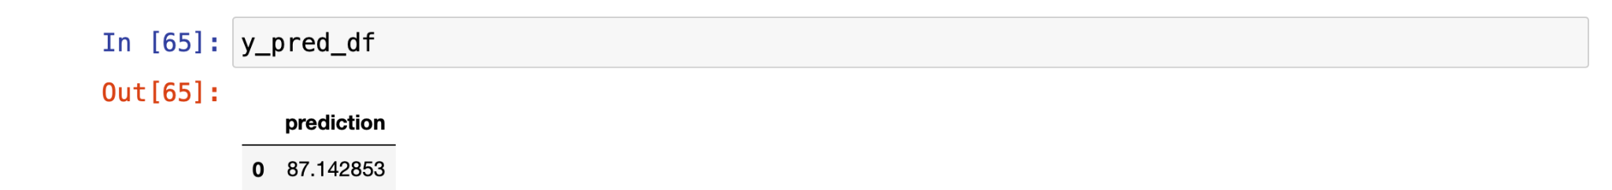
Findings

Slide 20
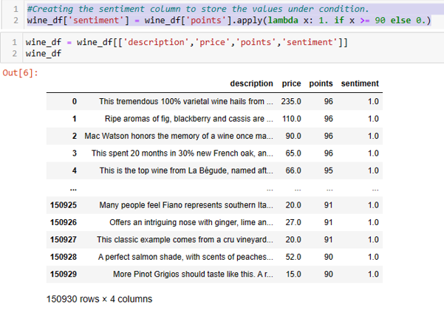
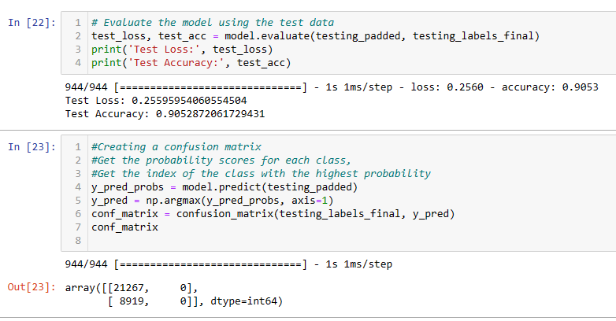
Machine Learning_Sentiment Analysis

Slide 21
Wine Selector Website
An additional aspect of this project was to create a website using JavaScript and HTML that allows users to filter through the WineEnthusiast data and select a wine according to their specific tastes. You are able to select some or all of the categories and type whatever you like, and the selector tool will draw from the dataset and show you all or any of the wines that match your search.

Slide 22
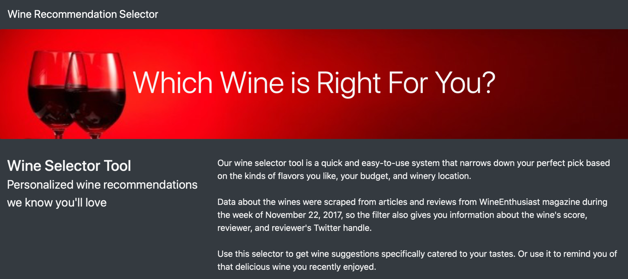

Slide 23
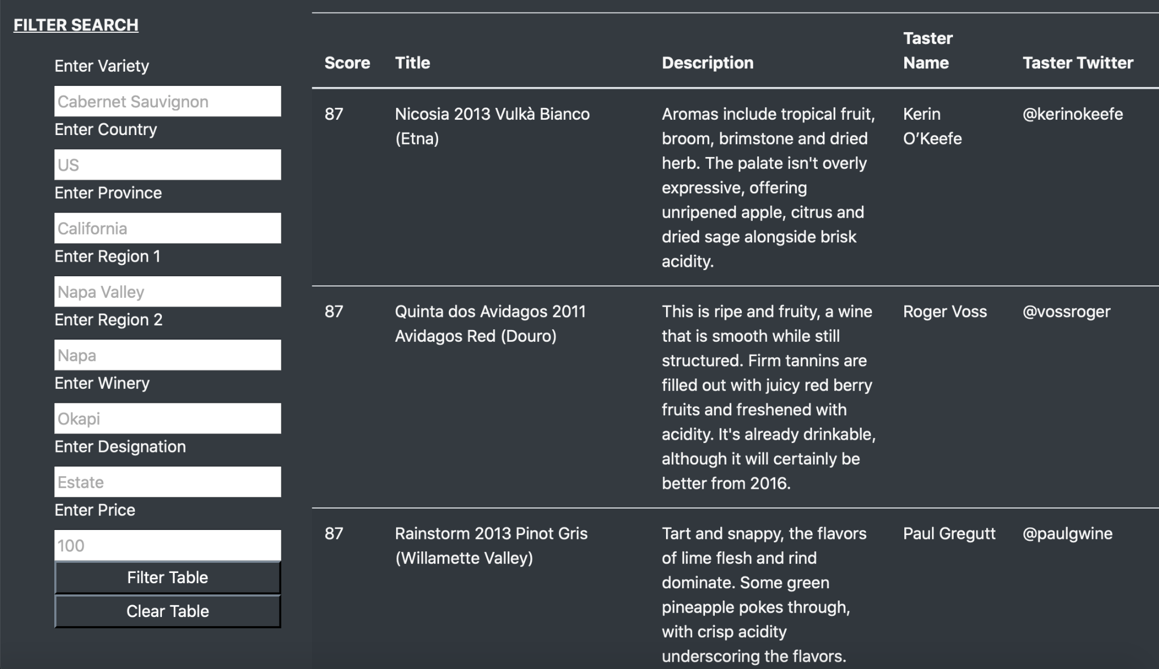

Slide 24
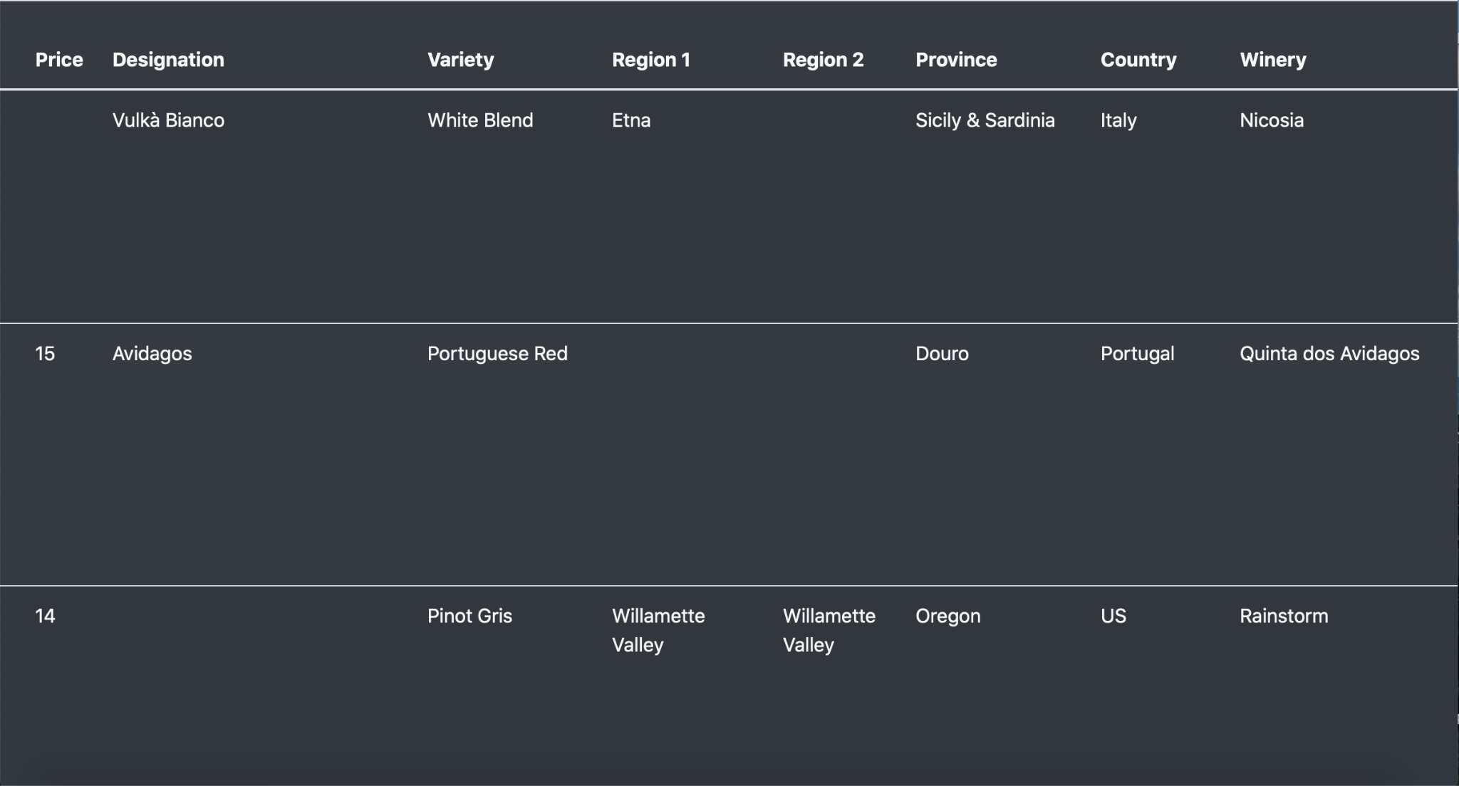

Slide 25
Recommendations
Since Chardonnay received the highest number of rating above 90 we recommend highly conjuring producing this type of wine.
We recommend producing the wine with the Williams Selyem winery as it has produced the highest number of wines with ratings over 90.
Finally, we recommend pricing the wine at around $33 as this appeared to be the average price of the highest performing wine.

